Slide 1

WEB DEVELOPMENT WORKSOP - CSS
Venue : CSE Seminar Hall
Timings : 9:30AM to 12:40PM

Slide 2
How does CSS look like :
body {
background-color: lightblue;
}
h1 {
color: white;
text-align: center;
}
p {
font-family: verdana;
font-size: 20px;
}
CSS is the language we use to style an HTML document.
CSS describes how HTML elements should be displayed.
External stylesheets are stored in CSS files

Slide 3
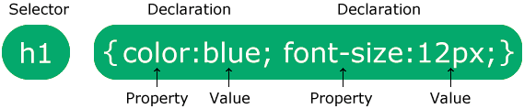
CSS Syntax :
The selector points to the HTML element you want to style.
The declaration block contains one or more declarations separated by semicolons.
Each declaration includes a CSS property name and a value, separated by a colon.
Multiple CSS declarations are separated with semicolons, and declaration blocks are surrounded by curly braces.
p {
color: red;
text-align: center;
}

Slide 4
3 Ways to insert CSS :
There are three ways of inserting a style sheet:
External CSS
Internal CSS
Inline CSS

Slide 5
External CSS:
External styles are defined within the <link> element, inside the <head> section of an HTML page.
An external style sheet can be written in any text editor, and must be saved with a .css extension.
The external .css file should not contain any HTML tags.
Here is how the "mystyle.css" file looks:
<!DOCTYPE html>
<html>
<head>
<link rel="stylesheet" href="mystyle.css">
</head>
<body>
<h1>This is a heading</h1>
<p>This is a paragraph.</p>
</body>
</html>
mystyle.css
body {
background-color: lightblue;
}
h1 {
color: navy;
margin-left: 20px;
}

Slide 6
Internal CSS
<!DOCTYPE html>
<html>
<head>
<style>
body {
background-color: linen;
}
h1 {
color: maroon;
margin-left: 40px;
}
</style>
</head>
<body>
<h1>This is a heading</h1>
<p>This is a paragraph.</p>
</body>
</html>
An internal style sheet may be used if one single HTML page has a unique style.
The internal style is defined inside the <style> element, inside the head section.

Slide 7
Inline CSS
An inline style may be used to apply a unique style for a single element.
To use inline styles, add the style attribute to the relevant element. The style attribute can contain any CSS property.
<!DOCTYPE html>
<html>
<body>
<h1 style="color:blue;text-align:center;">This is a heading</h1>
<p style="color:red">This is a paragraph.</p>
</body>
</html>

Slide 8
CSS Colors:
Colors are specified using predefined color names, or RGB, HEX, HSL values.
<h1 style="color: DodgerBlue;">Hello World</h1>
<h1 style="background-color:rgb(255, 99, 71);">Hello World</ h1>
<h1 style="background-color:#ff6347;"> Hello World </h1>
<h1 style="background-color:hsl(9, 100%, 64%);“> Hello World </h1>

Slide 9
CSS Background
The CSS background properties are used to add background effects for elements.
Some of them are:
background-color
background-image
The opacity property specifies the opacity/transparency of an element. It can take a value from 0.0 - 1.0. The lower value, the more transparent:
body {
background-image: url(“sky.jpg");
}
div {
background-color: blue;
opacity: 0.5;
}

Slide 10
CSS Height Width Property
The width property sets the width of an element.
The width of an element does not include padding, borders, or margins.
The min-width and max-width properties override the width property.
The height and width properties may have the following values:
auto - This is default. The browser calculates the height and width
length - Defines the height/width in px, cm, etc.
% - Defines the height/width in percent of the containing block
initial - Sets the height/width to its default value
div {
height: 200px;
width: 50%;
background-color: powderblue;
}

Slide 11
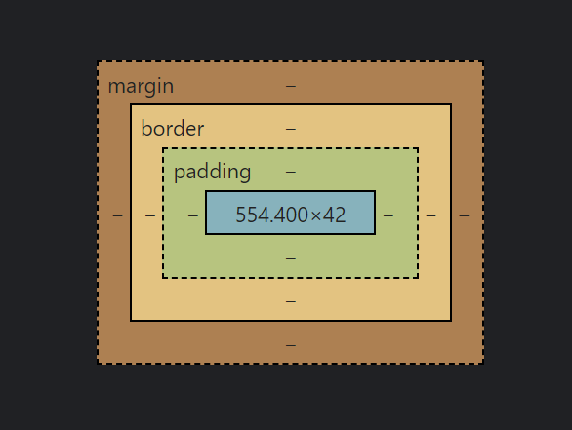
CSS Margin, Border & Paddings:

Slide 12
CSS Margins :
CSS has properties for specifying the margin for each side of an element:
margin-top
margin-right
margin-bottom
margin-left
All the margin properties can have the following values:
auto - the browser calculates the margin
length - specifies a margin in px, pt, cm, etc.
% - specifies a margin in % of the width of the containing element
p {
margin-top: 100px;
margin-bottom: 100px;
margin-right: 150px;
margin-left: 80px;
}

Slide 13
CSS Borders
The CSS border properties allow you to specify the style, width, and color of an element's border.
The border-style property specifies what kind of border to display.
dotted
dashed
solid
double
groove
ridge
inset
outset
none
hidden
p .border {
border-style: double;
border-width: 5px;
border-color: green;
}

Slide 14
CSS Padding
Padding is used to create space around an element's content, inside of any defined borders.
CSS has properties for specifying the padding for each side of an element:
padding-top
padding-right
padding-bottom
padding-left
All the padding properties can have the following values:
length - specifies a padding in px, pt, cm, etc.
% - specifies a padding in % of the width of the containing element
inherit - specifies that the padding should be inherited from the parent element
div {
border: 1px solid black;
padding-top: 50px;
padding-right: 30px;
padding-bottom: 50px;
padding-left: 80px;
}

Slide 15
CSS Flex Box
To start using the Flexbox model, you need to first define a flex container.
The flex container becomes flexible by setting the display property to flex.
The flex container properties are:
flex-direction
flex-wrap
justify-content
align-items
align-content
<div class="flex-container">
<div>1</div>
<div>2</div>
<div>3</div>
</div>
.flex-container {
display: flex;
}

Slide 16
CSS Flex Direction
The flex-direction property defines in which direction the container wants to stack the flex items.
The values for this can be:
column
column-reverse
row
row reverse
.flex-container {
display: flex;
flex-direction: column;
}

Slide 17
CSS Flex Wrap
The wrap value specifies that the flex items will wrap if necessary:
The values for this can be:
wrap
nowrap
wrap-reverse
.flex-container {
display: flex;
flex-wrap: wrap;
}

Slide 18
CSS Flex Justify Content & Align Items
The align-items property is used to align the flex items.
The values for this can be:
center
flex-start
flex-end
stretch
Baseline
The align-content property is used to align the flex lines.
The values for this can be:
space-around
space-between
stretch
center
flex-start
flex-end
.flex-container {
display: flex;
height: 300px;
justify-content: center;
align-items: center;
}

Slide 19
CSS Navigation Bar
A navigation bar is basically a list of links using the <ul> and <li> elements
<ul>
<li><a href="default.asp">Home</a></li>
<li><a href="news.asp">News</a></li>
<li><a href="contact.asp">Contact</a></li>
<li><a href="about.asp">About</a></li>
</ul>

Slide 20
Nav Bar CSS File
ul {
list-style-type: none;
margin: 0;
padding: 0;
overflow: hidden;
background-color: #333;
}
li {
float: left;
}
li a {
display: block;
color: white;
text-align: center;
padding: 14px 16px;
text-decoration: none;
}
li a:hover {
background-color: #111;
}

